Slide 1
Replication of A New Approach to Estimating the Production function for Housing
Aniruddha Dutta
Mansi Rathod
Mayur Gupta
Pradeep Prabhakar
Sreeja Vishaly Manohar
A reference implementation of:
Epple, Dennis, Brett Gordon, and Holger Sieg. 2010. “A New Approach to Estimating the Production Function for Housing.” American Economic Review, 100 (3): 905-24.DOI: 10.1257/aer.100.3.905
Replication GitHub Repository: https://github.com/ReplicationStudy/ReplicationStudyToEstimatePFforHousing

Slide 2
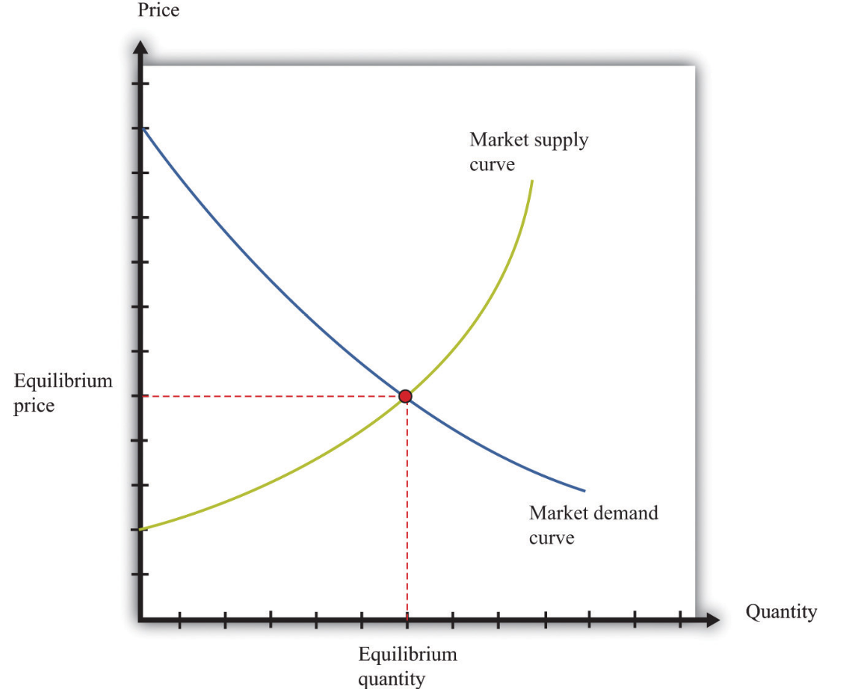
Target paper - Estimating Production function for housing
Production function: A channel linking variation in attractiveness of locations and housing consumption in urban economies
Challenge :Estimation is challenging because of the non-availability of quantity and price per unit of housing
Research question : Develop a flexible approach to estimate the production function by treating quantity and price as latent variables and use value of housing per unit of land
Results : Estimated the supply and production functions for residential properties in Allegheny county, pennsylvania.
Why replicate? An interesting economic experiment that helps us to understand how price of a land and value of housing are related in estimating the supply and production functions.
Just a classic supply-demand graph

Slide 3
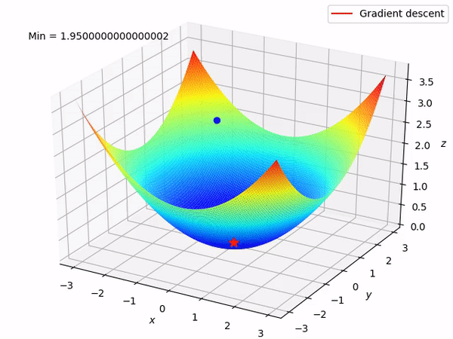
Scientific claims of Interest
Claim : Based on the observed variation in land prices and housing values per unit of land, Epple, Gordon, and Sieg (2010) has provided an algorithm to identify the housing supply function per unit of land and the subsequent production function
Method :
OLS estimates using log-linear, linear, quadratic and cubic models for modeling value vs price.
Ordinary differential equations to estimate supply functions
Replication variant:
Outlier treatment(Top and Bottom 1 percentiles).
Used GLM log-linear model and Log Linear model using gradient descent loss function in addition to OLS estimates
Replicated the plots of 95% CI bands for supply and production function estimates for the GLM log-linear model
Run, Forrest, run!!

Slide 4
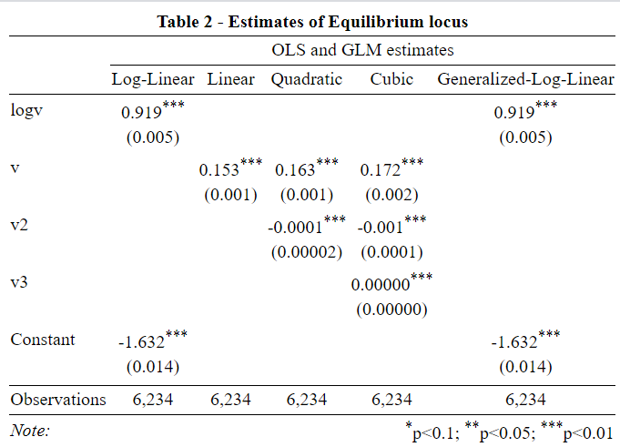
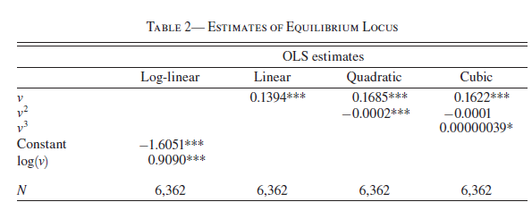

Replicating regression model and estimates
Estimates of equilibrium locus(Epple, Gordon, and Sieg 2010)
The coefficient of variable log(𝝂*) and intercept are similar to the values provided in the paper
Based on these values we were able to confirm that the coefficients estimated were consistent
* 𝝂 - Value per unit of land

Slide 5
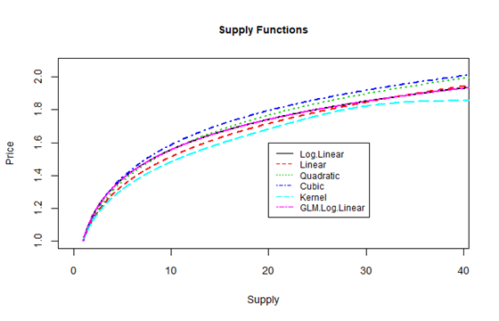
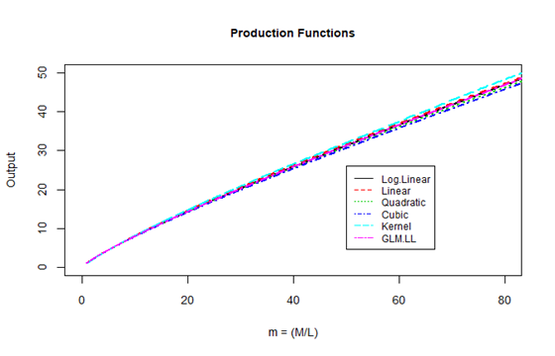
Supply and Production functions for OLS and Kernel models
While the target paper do not have plots for the above figures, we were able to replicate their claim which states that the supply and production functions for parametric , non-parametric estimates of coefficients to be similarly shaped.
GLM log linear model closely follows the Log Linear model* as observed.
* Log Linear model was used for the calculations in the original paper

Slide 6
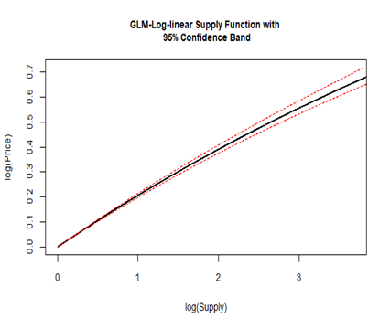
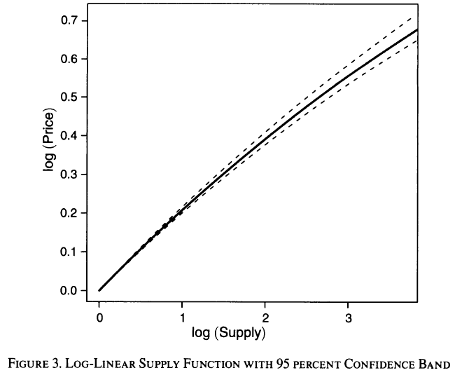
Supply function for GLM with 95% confidence interval
We were able to produce a similar plot for GLM log-linear supply function whereas the original paper was based on log-linear supply function

Slide 7
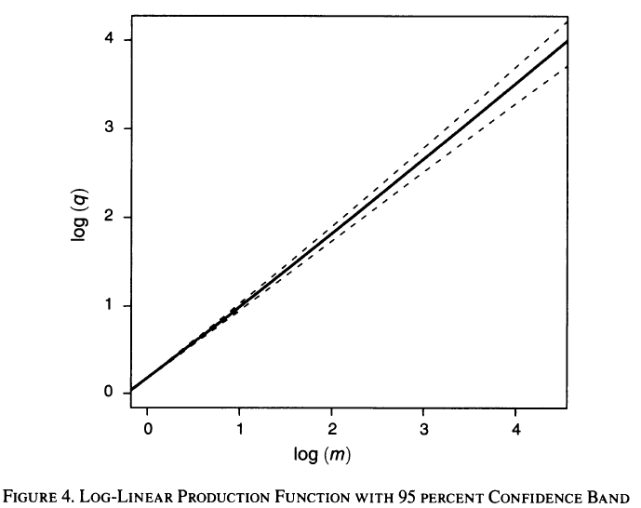
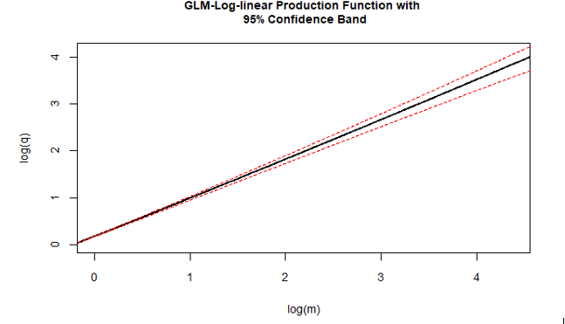
Production function for GLM with 95% confidence interval
We were able to produce a similar plot for GLM log-linear production function whereas the original paper was based on log-linear supply function

Slide 8
Reflections
A package named “Odesolve” used for calculating n^{th} order derivative was deprecated. Mansi had to replicate the R code using another package called “deSolve”
The percentile values used in the R code, were not consistent and were hard coded. Aniruddha automated the code snippet and did some code cleanup.
Variables used in the code were misspelled in some places, Sreeja had to track them back to their source functions and fix them
Implementation of Log Linear model with Gradient Descent Loss function was tricky. Mayur and Pradeep ensured that we replicate the exact model, by running the model with multiple permutations of learning rate* and number of iterations.
The team members were new to R markdown before the start of this project and the exercise served as a great value add to explore the possibilities of Rmd.
While the team faced the above challenges, the codes and the data from the original paper performed as intended and made our replication study a lot easier.
* The coefficient of log(𝝂) could be replicated only when the learning rate was 0.1

Slide 9

Thank you!

